Slide 1
A Mini Project On
“3D CAR SIMULATION”

Slide 2
CONTENTS
Introduction
Application
Implementation
Results
Conclusion
References

Slide 3
Introduction
A car is a useful for transportation from one place to another place. Since many years the automobiles have been subjected to continuous evolution and hence a variety of car models with each one having its own features, shape and size exist today. This is an approach to simulate the working of one such model of a car. The car used here is a 3D object with simple features. One can either view the car model or enter into the driving mode. In the former case, the car is placed against a plain background whereas in the latter case, it is placed on a road having greenery in the background.

Slide 4
The car can be moved to and forth, rotated about the three principle axes and can be changed in terms of size and color. Along with the above features the fog and wheel effects can also be imposed on the car. The car can be viewed either in the day mode or in the night mode. A uniform lighting effect is also included, however it is left to the user to enable or disable lighting. Also, the car can be zoomed in or zoomed out. All these actions can be performed by using the menu provided.

Slide 5
Application
Automotive Design and Engineering : 3D car simulation is extensively used in the automotive industry for designing and engineering vehicles.
Driver Training and Education : 3D car simulations are used in driver training programs to provide a safe and controlled environment for learners to practice their driving skills.
Entertainment and Gaming : 3D car simulations are widely used in the entertainment industry, especially in video games and racing simulations.
Autonomous Vehicle Development : 3D car simulations play a crucial role in the development and testing of autonomous vehicles.

Slide 6
Implementation
Transform,InitGL, Function
to initialize and manipulate the OpenGL environment
2. ReSizeGLScene Function
handle window resizing
3. glLineWidth Function
The glLineWidth function specifies the width of rasterized lines.
4. DrawGLScene Function
draw various geometric shapes and objects.
5. glutInit Function
Initializes GLUT, if arguments are passed then they are passed from the main and can be used by the application.
6. glutBitmapCharacter
7. gluNewQuadric
The gluNewQuadric function creates and returns a pointer to a new quadric object.
glutBitmapCharacter renders a bitmap character using OpenGL.

Slide 7
8. gluPerspective Functions
The gluPerspective function sets up a perspective projection matrix.
9. gluQuadricDrawStyle Function
The gluQuadricDrawStyle function specifies the draw style desired for quadrics.
10. gluOrtho2D function
Defines a two dimensional viewing rectangle in the plane.
11. glMatrixMode Function
The glMatrixMode function specifies which matrix is the current matrix
12. glRasterPos2f Function
X : Specifies the x-coordinate for the current raster position.
Y: Specifies the y-coordinate for the current raster position.

Slide 8
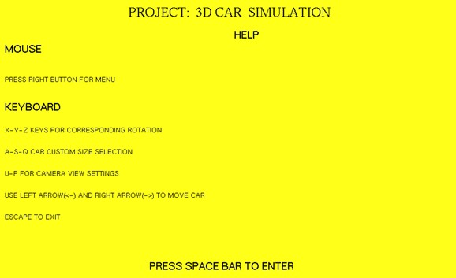
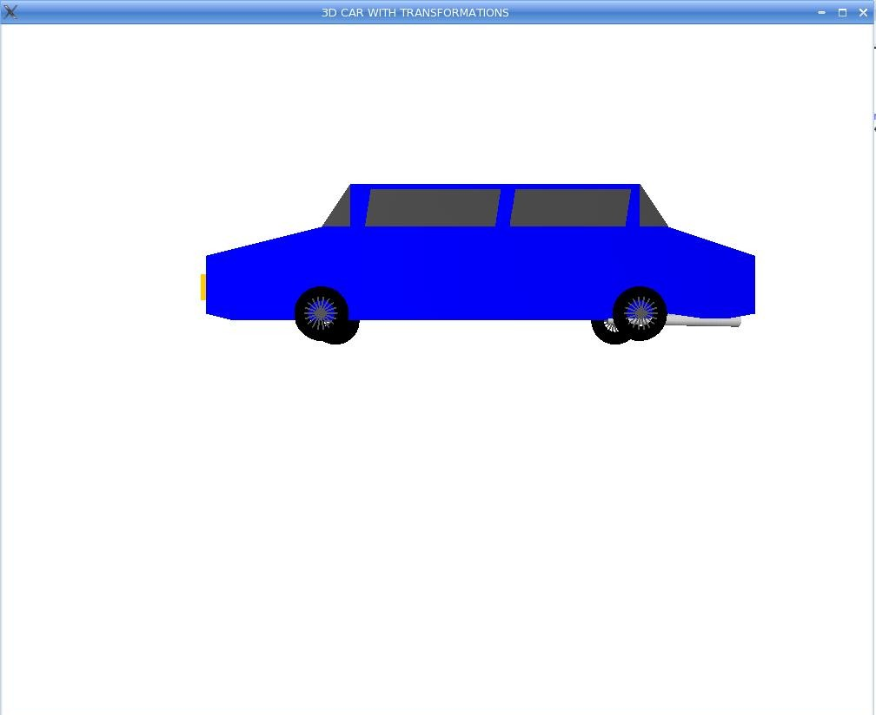
Results

Slide 9
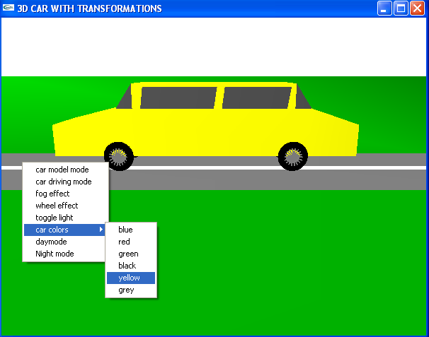
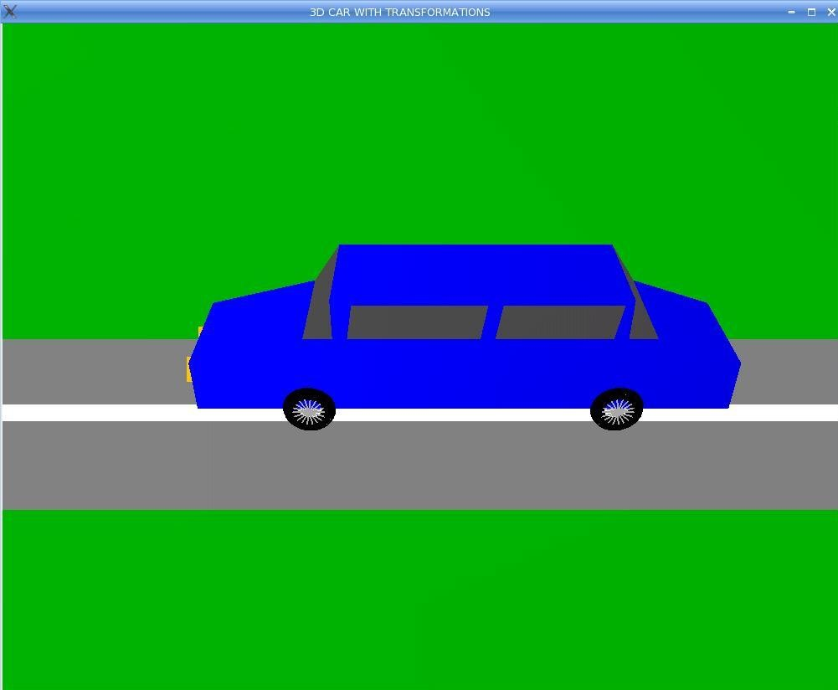

Slide 10
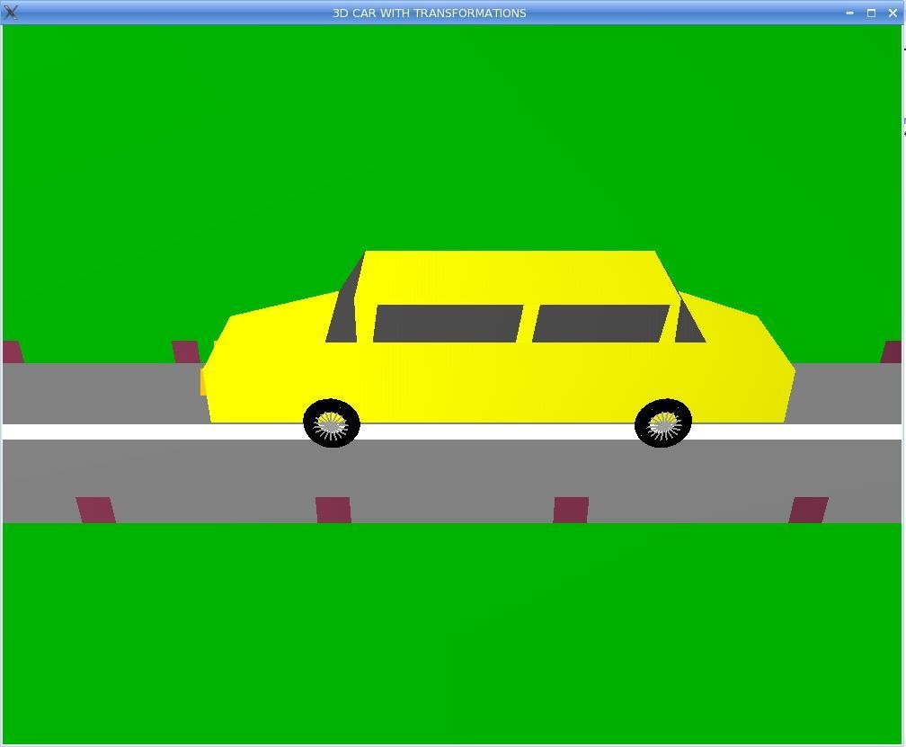
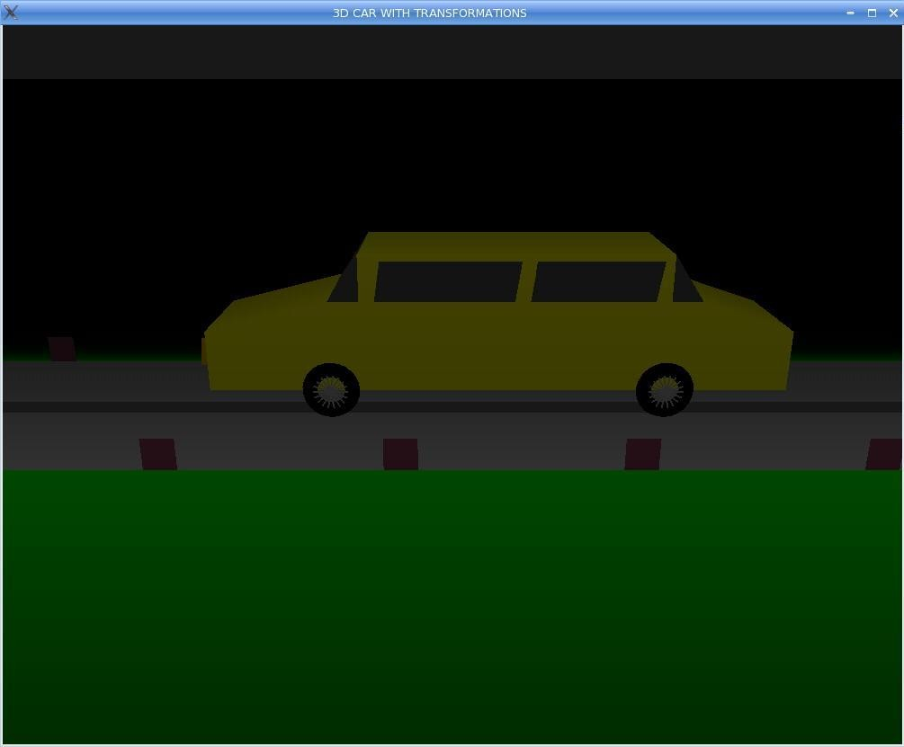

Slide 11
Conclusion & Future Scope
Conclusion :
After the completion of this project, we came to know how we can implement a project using an Open-source OpenGL tool kit. By implementing a project using Open GL we came to know how to use the functions like menu ‘s, rotation, translation and scaling
Future scope :
In future many other 3D geometrical shapes can be added to improve the epilogue of education project.More buttons are implemented to move the objects. For example opening and closing the doors of cars using left and right arrows of the keyboard

Slide 12
References
Books:
[1] Edward Angel, Interactive Computer Graphics :A Top-Down Approach Using OpenGL, Fifth edition, Addison Wilsey, 2009.
[2]Hearnand Pauline Baker, Computer Graphics-C version, Second edition ,Pearson Education,2003
Web References:
[1] www.wikipedia.com
[2] http://www.engineeringresources.com
[3] http://opengl.com
[4] http://www.stackoverflow.com

